Slide 1
Fast, Lean, and Accurate: Modeling Password Guessability Using Neural Networks
William Melicher, Blase Ur, Sean M. Segreti, Saranga Komanduri, Lujo Bauer,
Nicolas Christin, and Lorrie Faith Cranor, Carnegie Mellon University
Presenter: Ihtisham Ali

Slide 2
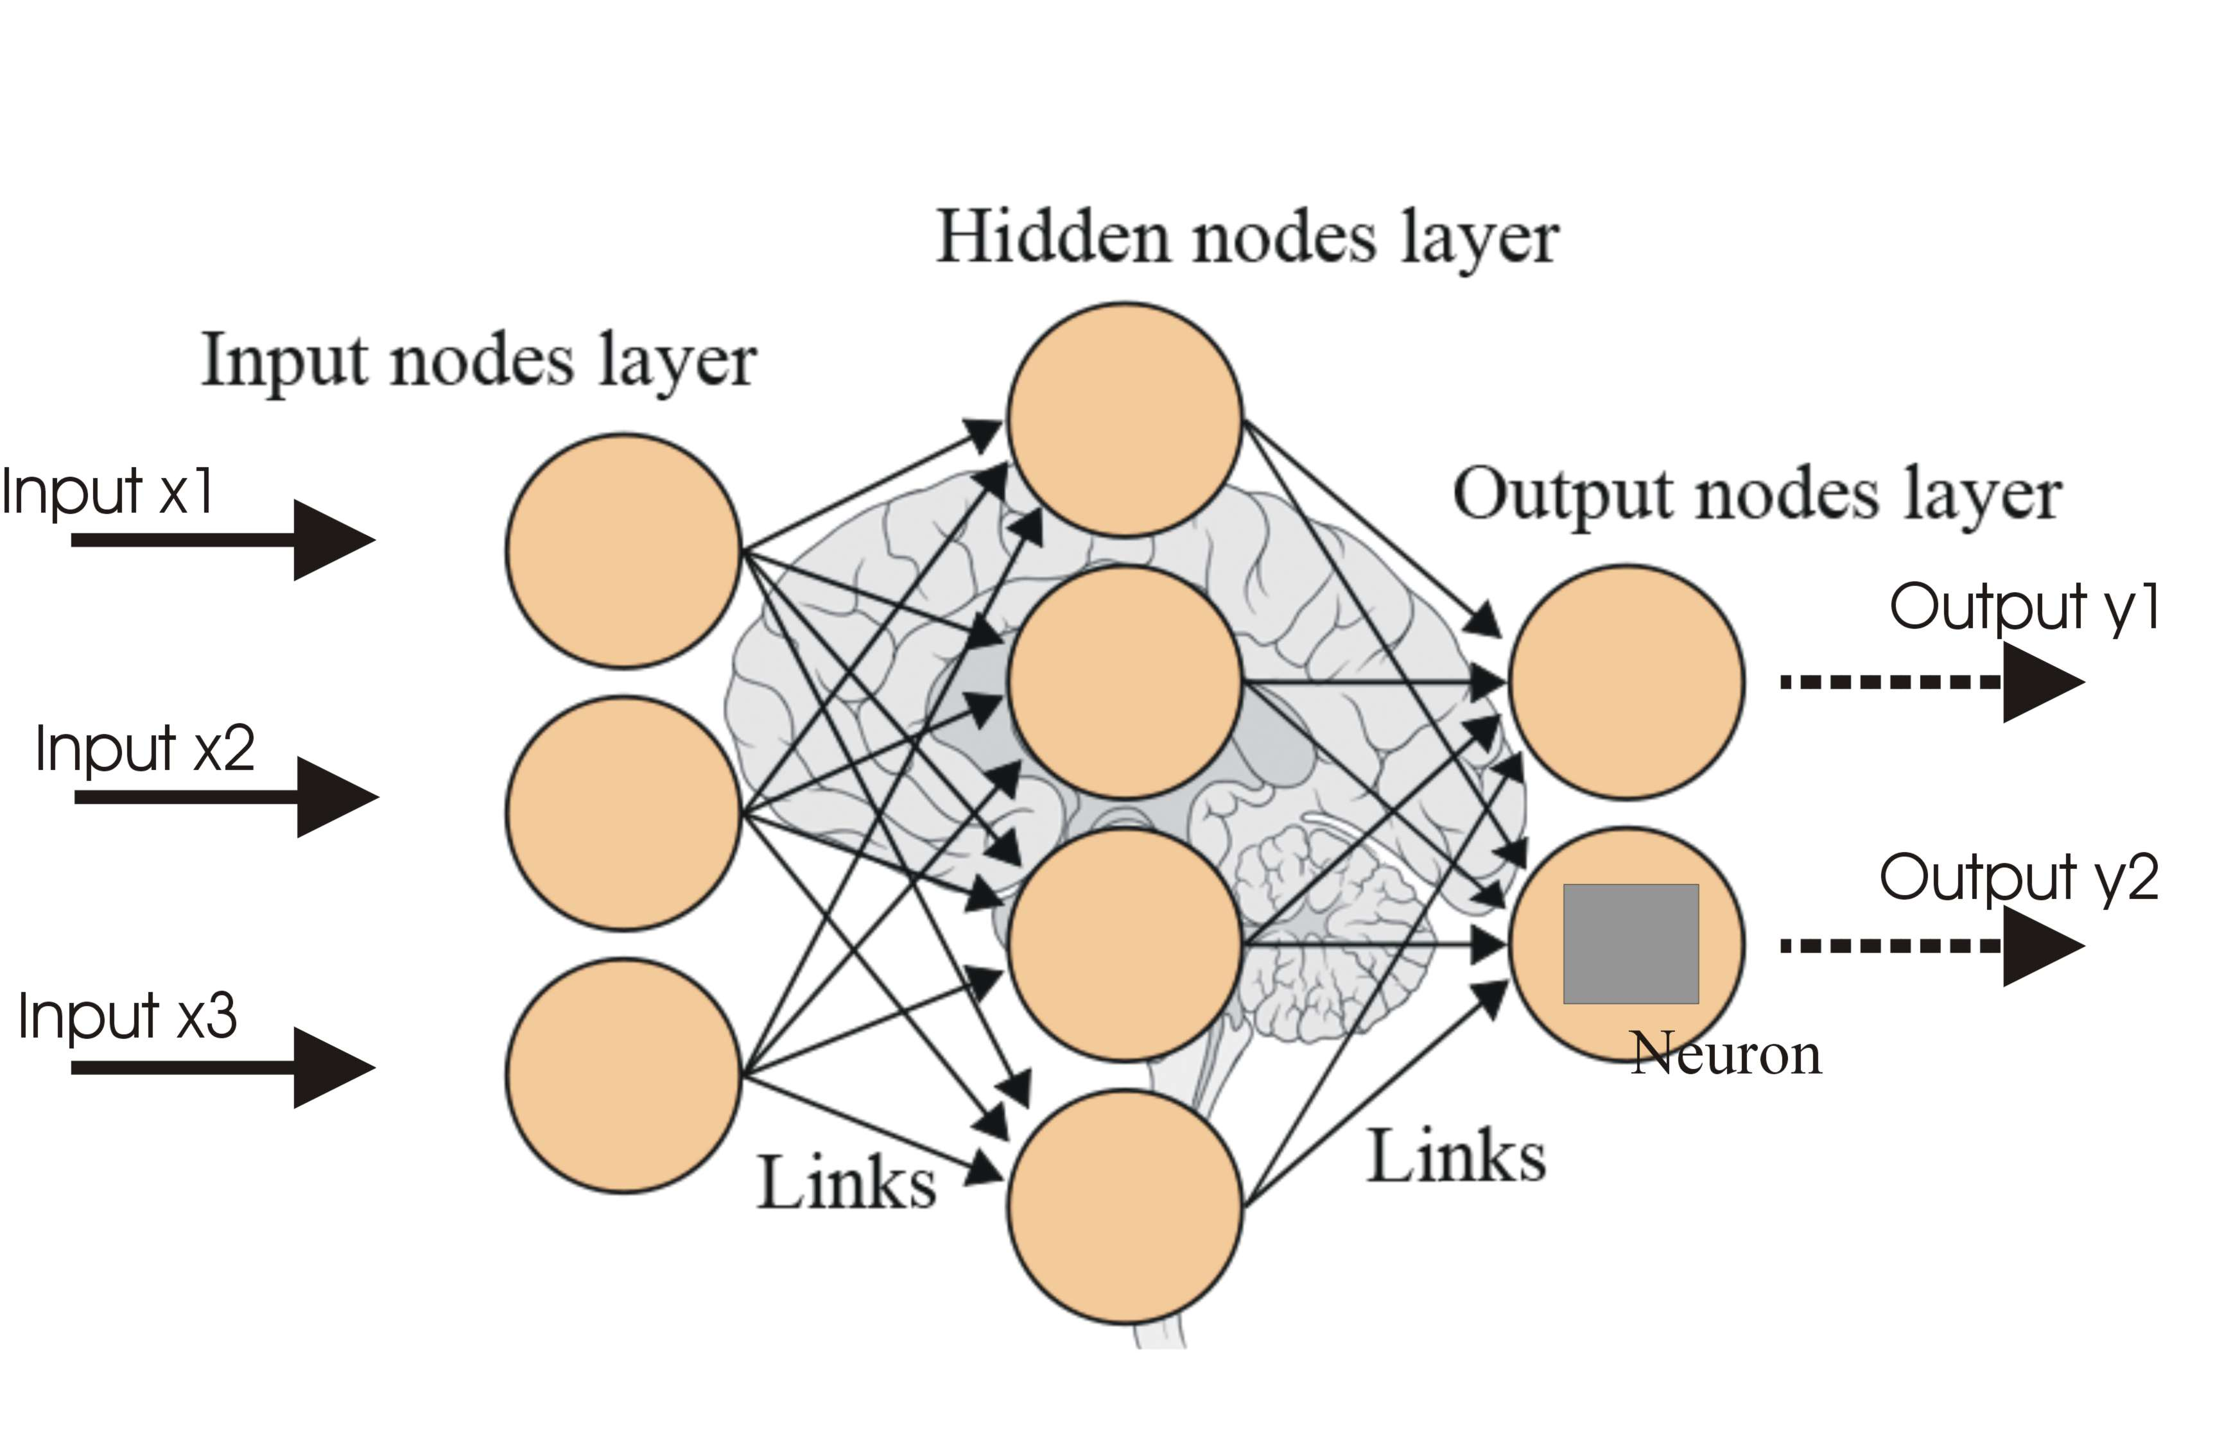
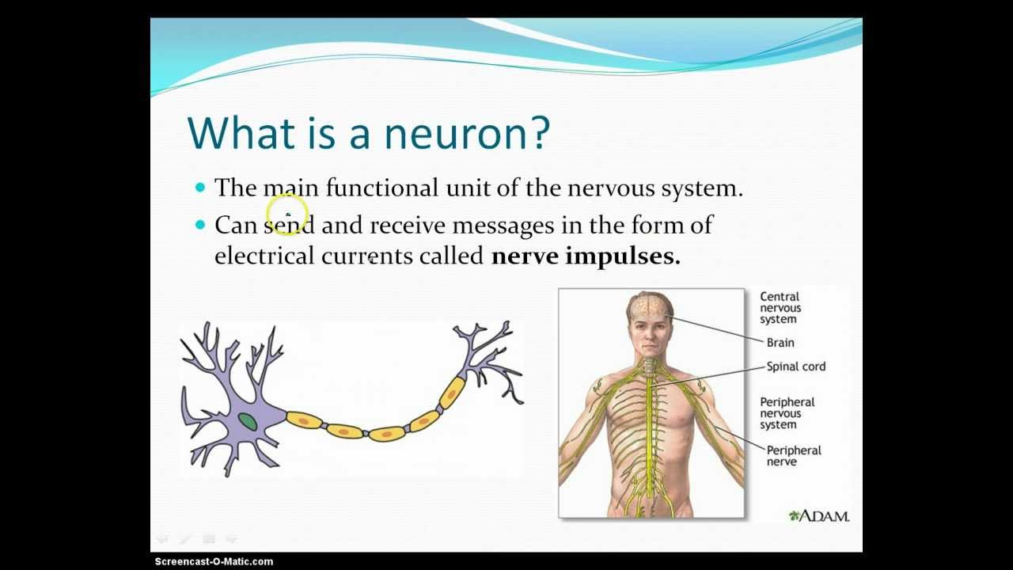
Neural Network

Slide 3
Problem Statement
Human-chosen text passwords, today’s dominant form of authentication, are vulnerable to guessing attacks (Brute force and Dictionary attack).
Unfortunately, existing approaches for evaluating password strength by modeling adversarial password guessing are either inaccurate or orders of magnitude too large and too slow for real-time, client-side password checking.
We propose using artificial neural networks to model text passwords’ resistance to guessing attacks and explore how different architectures and training methods impact neural networks’ guessing effectiveness.
With the goal of gauging the strength of human-chosen text passwords both more accurately and more practically, we propose using artificial neural networks to guess passwords.

Slide 4
Existing Guessing Methods
John the Ripper (Dictionary word + Rules)
Hashcat (Password + Append 2 digits) e.g. password11
Markov Models
PCFGs

Slide 6
Research Questions
Can we guess more accurately?
Quicker?
With fewer resources?

Slide 8
Benefits of using Neural Networks
Neural networks guess passwords more successfully than other password-guessing methods in general.
The neural networks we use can be highly compressed with minimal loss of guessing effectiveness.
This approach is thus far more suitable than existing password-guessing methods for client-side password checking.
We can compress such a neural network into hundreds of kilobytes, which is small enough to be included in an app for mobile devices, bundled with encryption software, or used in a web page password meter.
Our implementation gives real-time feedback on password strength in fractions of a second, and it more accurately measures resistance to guessing than existing client-side methods.

Slide 9
Contribution
First, we propose neural networks as a model for guessing human chosen passwords and comprehensively evaluate how varying their training, parameters, and compression impacts guessing effectiveness
Second, leveraging neural networks, we create a password-guessing model sufficiently compressible and efficient for client-side proactive password checking.
Third, they build and benchmark a JavaScript implementation of such a checker.

Slide 10
3 System Design

Slide 11
3.1 Measuring Password Strength
We use beam-search because breadth-first’s memory requirements do not scale, and because it allows us to take better advantage of GPU parallel processing power than depth-first search.
A Major Advantage over Markov model is that neural network model can be efficiently implemented on the GPU.
Calculating Guess Numbers
In evaluating password strength by modeling a guessing attack, we calculate a password’s guess number, or how many guesses it would take an attacker to arrive at that password if guessing passwords in descending order of likelihood.
The Traditional method of calculating guess numbers by enumeration is computationally intensive.
For example enumerating more than ₁₀¹⁰ passwords would take roughly 16 days in our unoptimized implementation on an Nvidia GeForce GTX 980 Ti.
However, in addition to guess number enumeration, we can also estimate guess numbers accurately and efficiently using Monte Carlo simulations, as proposed by Dell’Amico and Filippone.
Monte Carlo simulation is a computerized mathematical technique that allows people to account for risk in quantitative analysis and decision making.
Monte Carlo simulation furnishes the decision-maker with a range of possible outcomes and the probabilities they will occur for any choice of action

Slide 12
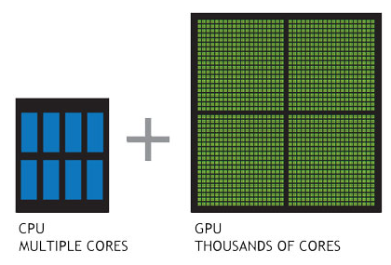
CPU VS GPU

Slide 13
3.2 Our Approach
3.2.1 Model Architectures
Use of Recurrent Neural Networks (RNN) because they have been shown to be useful for generating text in the context of character-level natural language.
RNN are a specific type of neural network where connections in the network can process elements in sequences and use an internal memory to remember information about previous elements in the sequence.
3.2.2 Alphabet Size
We focus on character-level models, rather than more common word-level models, because there is no established dictionary of words for password generation.
They decided to explore hybrid models based on prior work in machine learning.
In the hybrid construction, in addition to characters, the neural network is allowed to model sub-word units, such as syllables or tokens.

Slide 14
3.2.3 Model Size
We must also decide how many parameters to include in models. To gauge the effect of changing the model size on guessing success.
we test a large neural network with 15,700,675 parameters and a smaller network with 682,851 parameters.
The larger size was chosen to limit the amount of time and GPU memory used by the model, which required one and a half weeks to fully train on our larger training set.
The smaller size was chosen for use in our browser implementation because it could realistically be sent over the Internet; compressed, this network is a few hundred kilobytes.

Slide 15
3.2.4 Transference Learning
We experimented with a specialized method of training neural networks that takes advantage of transference learning, in which different parts of a neural network learn to recognize different phenomena during training.
One of the key problems with targeting non-traditional password policies is that there is little training data.
For example, in our larger training set, there are 105 million passwords, but only 2.6 million satisfy a password policy that requires a minimum of 16 characters.
Transference learning lets us train a model on all passwords, yet tailor its guessing to only longer passwords.

Slide 16
Contin……..
When using transference learning, the model is first trained on all passwords in the training set.
Then, the lower layers of the model are frozen. Finally, the model is retrained only on passwords in the training set that fit the policy.
The intuition is that the lower layers in the model learn low-level features about the data (e.g., that ‘a’ is a vowel), and the higher layers learn higher-level features about the data (e.g., that vowels often follow consonants).
3.2.5 Training Data
We experimented with different sets of training data.
First set was termed Password Guessability Service (PGS) (contains yahoo and Rockyou leaked passwords)
Second set, PGS ++ ( additional Leaked and cracked passwords)
Total set 105 millions and 5.9 millions of natural language words.

Slide 17
3.3 Client Side Models
Deploying client-side (e.g., browser-based) password strength-measuring tools presents severe challenges. Why?
To minimize latency experienced by users, these tools should execute quickly and transfer as little data as much possible over the network.
By combining a number of optimizations with the use of neural networks, we can build accurate password-strength measuring tools that are sufficiently fast for real-time feedback and small enough to be included in a web page.
3.3.1 Optimizing for Model Size
To deploy our prototype implementation in a browser, we developed methods for succinctly encoding it.
We leveraged techniques from graphics for encoding 3D models for browser-based games and visualizations.

Slide 18
Contin….
Our encoding pipeline contains four different steps: weight quantization, fixed-point encoding, ZigZag encoding, and lossless compression.
Our overall strategy is to send fewer bits and leverage existing lossless compression methods that are natively supported by browser implementations, such as gzip compression
Weight Quantization
First, we quantized the weights of the neural network to represent them with fewer digits.
Rather than sending all digits of the 32-bit floating-point numbers that describe weights, we only send the most significant digits. Weight quantization is routinely used for decreasing model size, but can increase error.

Slide 19
Fixed-point Encoding
Second, instead of representing weights using floating-point encoding, we used fixed point encoding.
Fixed-point encoding allows us to more succinctly describe the quantized values using unsigned integers rather than floating point numbers on the wire.
ZigZag Encoding
Third, negative values are generally more expensive to send on the wire.
To avoid sending negative values, we use ZigZag encoding.
In ZigZag encoding, signed values are encoded by using the last bit as the sign bit. So, the value of 0 is encoded as 0, but the value of -1 is encoded as 1, 1 is encoded as 2, -2 is encoded as 3, and so on.

Slide 20
Lossless Compression
We use regular gzip or deflate encoding as the final stage of the compression pipeline.
Both gzip and deflate produce similar results in terms of model size and both are widely supported natively by browsers and servers.
Bloom Filter Word List
To increase the success of client-side guessing, we also store a word list of frequently guessed passwords.
We stored the first two million most frequently occurring passwords in our training set in a series of compressed Bloom filters.
Because Bloom filters cannot map passwords to the number of guesses required to crack, and only compute existence in a set.

Slide 21
we use multiple Bloom filters in different groups: in one Bloom filter, we include passwords that require fewer than 10 guesses; in another, all passwords that require fewer than 100 guesses; and so on.
On the client, a password is looked up in each filter and assigned a guess number corresponding to the filter with the smallest set of passwords.

Slide 22
3.3.2 Optimizing for Latency
We rely on precomputation and caching to make our prototype sufficiently fast for real-time feedback.
The target latency is near 100 ms because that is the threshold below which updates appear instantaneous.
Precomputation
We precompute guess numbers instead of calculating guess numbers on demand because all methods of computing guess numbers on demand are too slow to give real-time feedback.
Precomputation decreases the latency of converting a password probability to a guess number: it becomes a quick lookup in a table on the client.

Slide 23
Caching Intermediate Results
We also cache results from intermediate computations. Calculating the probability of a 10-character password requires 11 full computations of the neural network, one for each character and one for the end symbol.
By caching probabilities of each substring, we significantly speed up the common case in which a candidate password changes by having a character added to or deleted from its end.
Multiple Threads
On the client side, we run the neural network computation in a separate thread from the user interface for better responsiveness of the user interface.

Slide 24
Conclusion
This makes it possible to build client-side password meters that provide a good measure of password strength.
Tuning neural networks for password guessing and developing accurate client-side password-strength metrics both remain fertile research grounds.
While we measured client-side strength metrics based on guessing effectiveness, a remaining challenge is giving user-interpretable advice to improve passwords during password creation.

